Slide 1





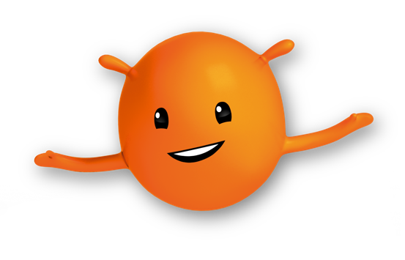
What’s Happening In The World
This Week?
w/c 7th October 2024

Slide 2

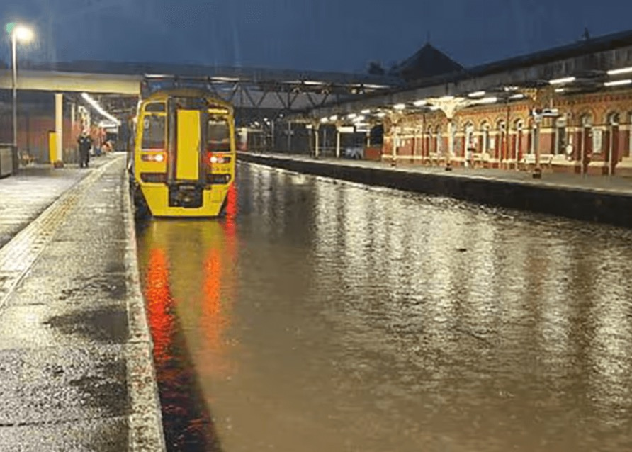

I’m sure lots of you have heard about this in the news this week...
But how many of you will have heard our news story...?
Flooding in England
(source: Network Rail/PA)

Slide 3

BIG
This week’s
Question
What is Earth about to get a second version of?
We will revisit this question
after this week’s story…

Slide 4




But first ...
Can you guess the location?
It is the third largest country in the world by both size and population.
One of the 7 Wonders of the World, The Grand Canyon, is in this country.
Although lots of people think it is basketball, the national sport is actually Baseball.

Slide 5
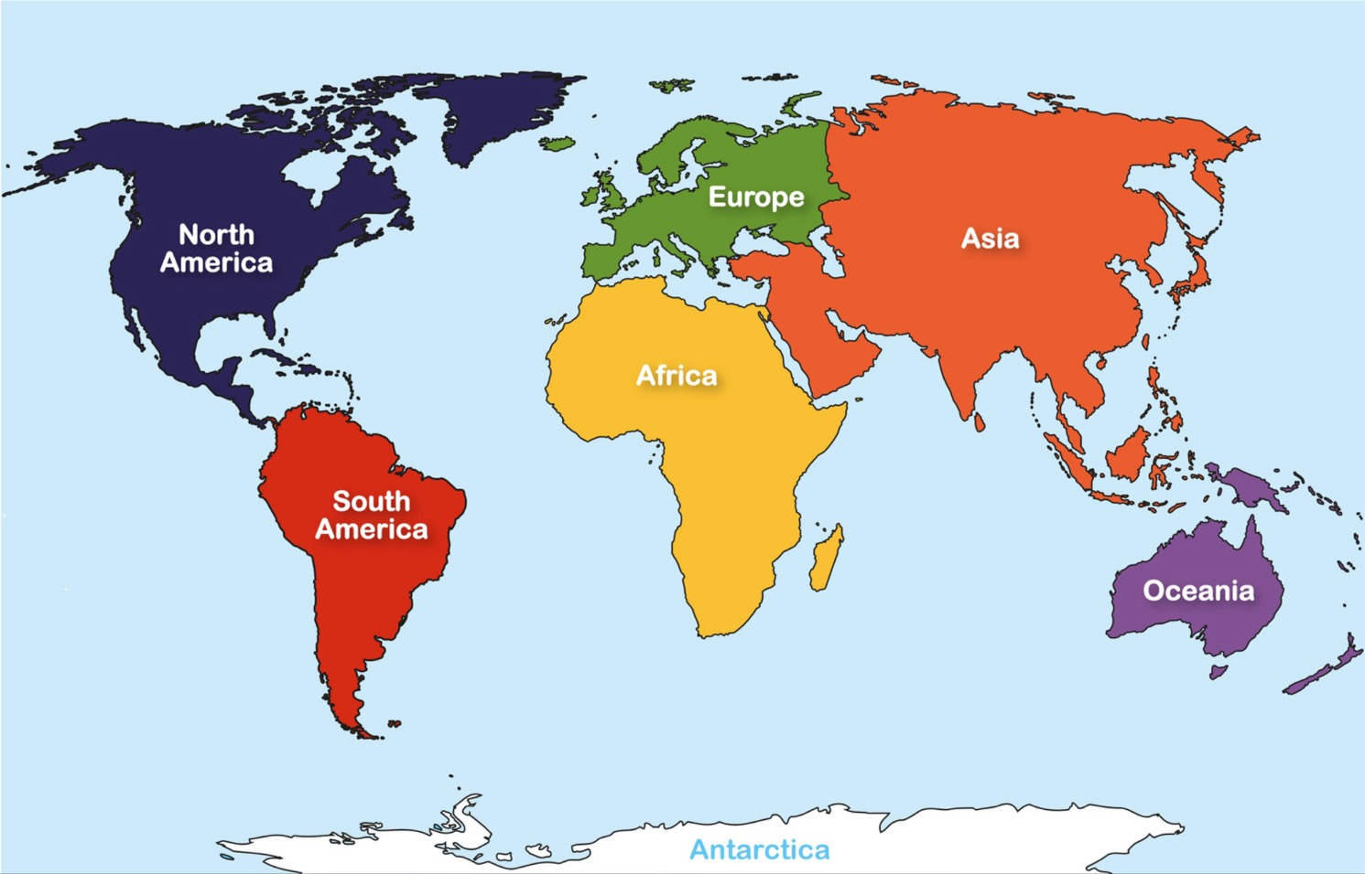





For this week’s story,
we are visiting...
USA

Slide 6

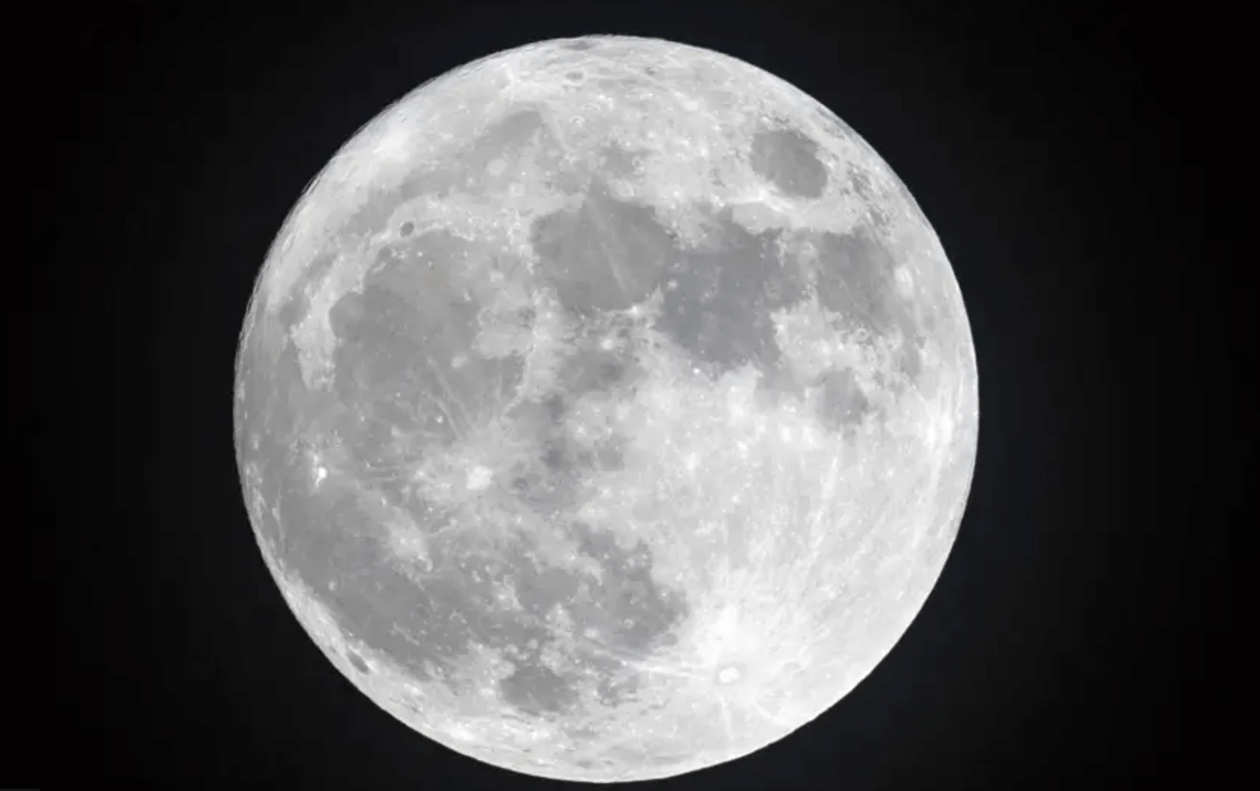

What?
Source: Getty Images
Earth is getting a "mini-moon"! This small asteroid, called 2024 PT5, will be caught by Earth's gravity starting on 29th September, 2024. It will orbit Earth for about two months before flying off again. However, it's too small to see without a professional telescope…
..However, there will be numerous locations in USA (including Hawaii, Wyoming and Colorado) with fully-equipped observatories on site, where people can go to view the “mini-moon”.

Slide 7
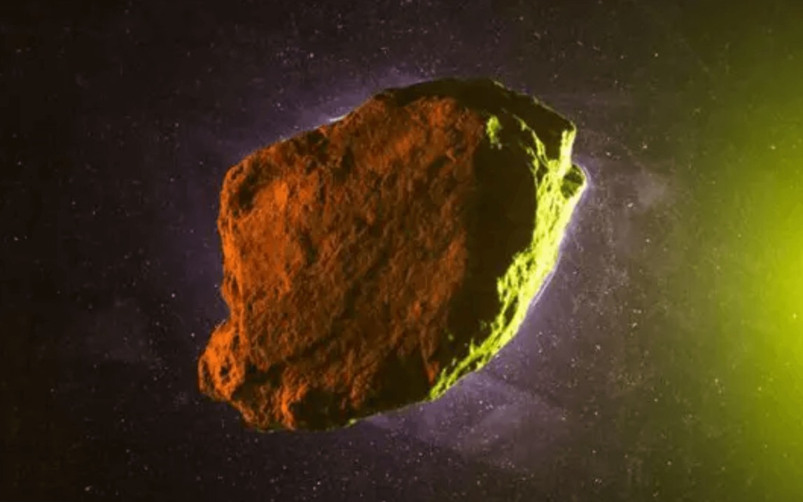

What?
Source: Getty Images
The mini-moon is about 32 feet long, which is much smaller than our regular moon.
Mini-moons have been spotted before, and some even come back! For example, asteroid 2022 NX1 was a mini-moon in 1981 and returned in 2022. So if you miss seeing 2024 PT5, don’t worry - scientists predict it should return in 2055!

Slide 8


1
How long is the mini-moon expected to orbit Earth for?
This week’s Recap...
2
When is the mini-moon expected to return?
Why do experts think the orcas are ramming into the boats?
1
...Last week
What two things do experts suggest doing to minimise the orcas’ behaviour?
2

Slide 9
1
How long is the mini-moon expected to orbit Earth for?
Around 2 months
This week’s Recap...
2
When is the mini-moon expected to return?
Scientists believe it will return in 2055
Why do experts think the orcas are ramming into the boats?
1
Because they are practising their hunting skills for catching tuna.
...Last week
What two things do experts suggest doing to minimise the orcas’ behaviour?
2
Making loud noises in the boat or changing the design of the boat to scare them off.

Slide 10




Time to revisit our
BIG question…
(and explore some other big questions while we’re here)
What is Earth about to get a second version of?
What causes the different shapes of the moon, like the crescent or full moon?
What would happen if there was no moon? How might Earth be different?

Slide 11

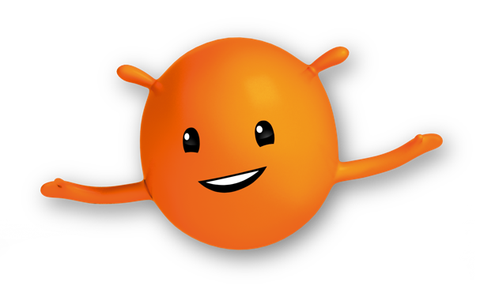
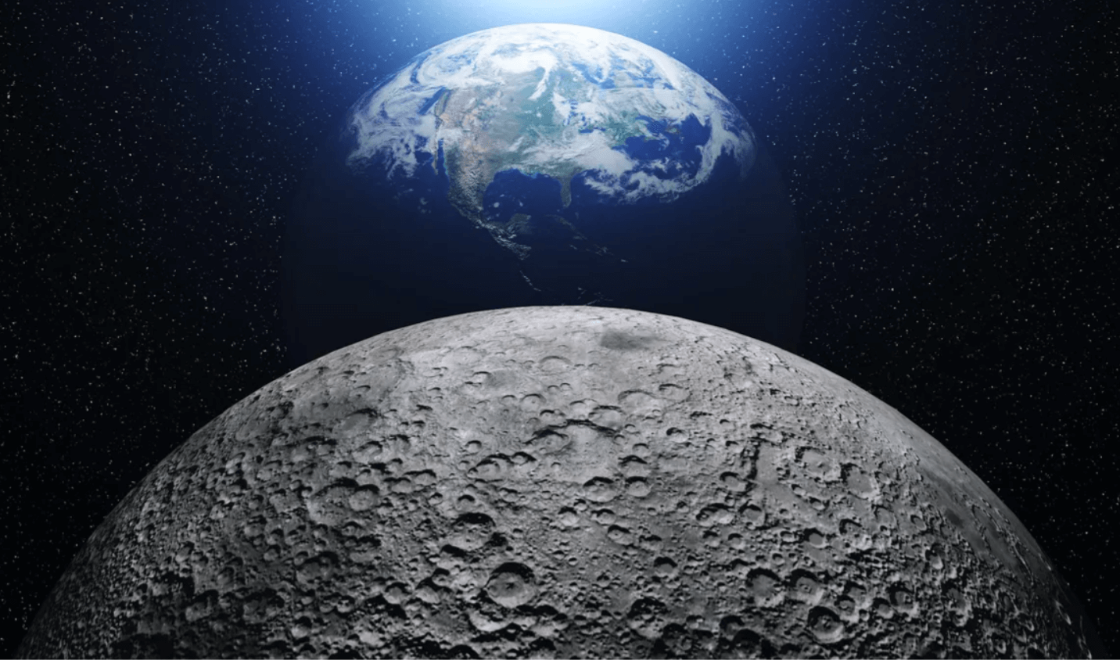
Weekly Challenge
CLOSEST
GUESS
WINS!
Approximately how many times would the moon fit inside Earth?
10
B. 25
C. 50
Source: mikiell via Getty Imagess

Slide 12

Weekly Challenge
CLOSEST
GUESS
WINS!
Approximately how many times would the moon fit inside Earth?
Answer:
50!
Source: mikiell via Getty Imagess

Slide 13

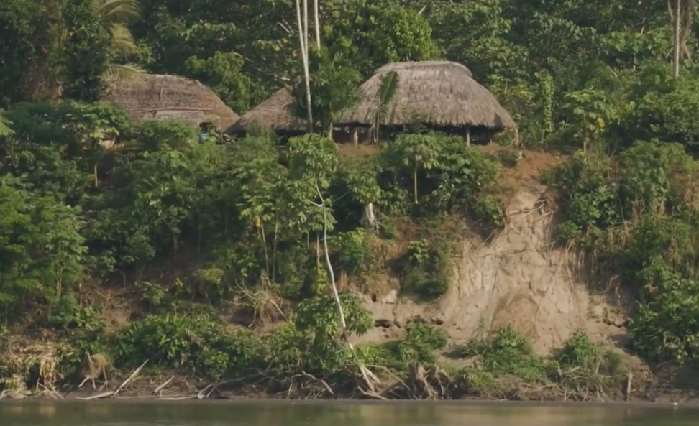
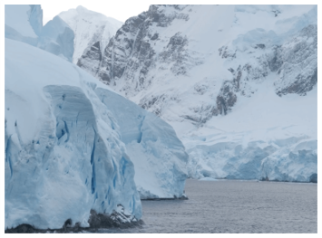
Discover the world’s geography from your classroom…
In January, we’ll be launching our brand new "Hot & Cold Adventure", where children will explore the hottest and coldest places on Earth, embarking on exciting journeys to the Amazon Rainforest and Antarctica!
www.oddizzi.com

